Slide 1


Data Structures
Week 14 Priority Queues/Heaps
Juan Carlos Pineda
ITESM
juancarlos.pineda@tec.mx

Slide 2

Priority Queue
Priority Queue Emergency Department waiting room operates as a priority queue: patients are sorted according to priority (urgency), not “first come, first serve” (in computer science, “first in, first out” or FIFO).

Slide 3
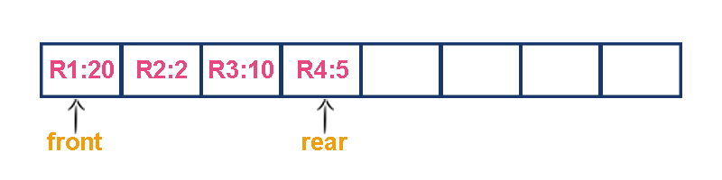
Priority Queues
Individual elements of our priority queue will have two pieces to them
An integer indicating the priority of this element
We will use smaller number means higher priority, but could be done either way
A “payload” of whatever the actual element data is
Examples:
A class MedicalRecord
A string or file with information to print

Slide 4
Priority Queues
Two priority queue implementation options
Unsorted Array
Always insert a new element at the end of the array
Remove by searching entire array for highest-priority item, then removing it, and if needed moving elements over to fill in the gap

Slide 5
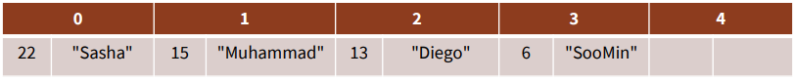
Priority Queues
Sorted array
Always insert new elements where they go in priority-sorted order, with the highest-priority item at the end of the array
Remove by taking the last element of the array

Slide 6
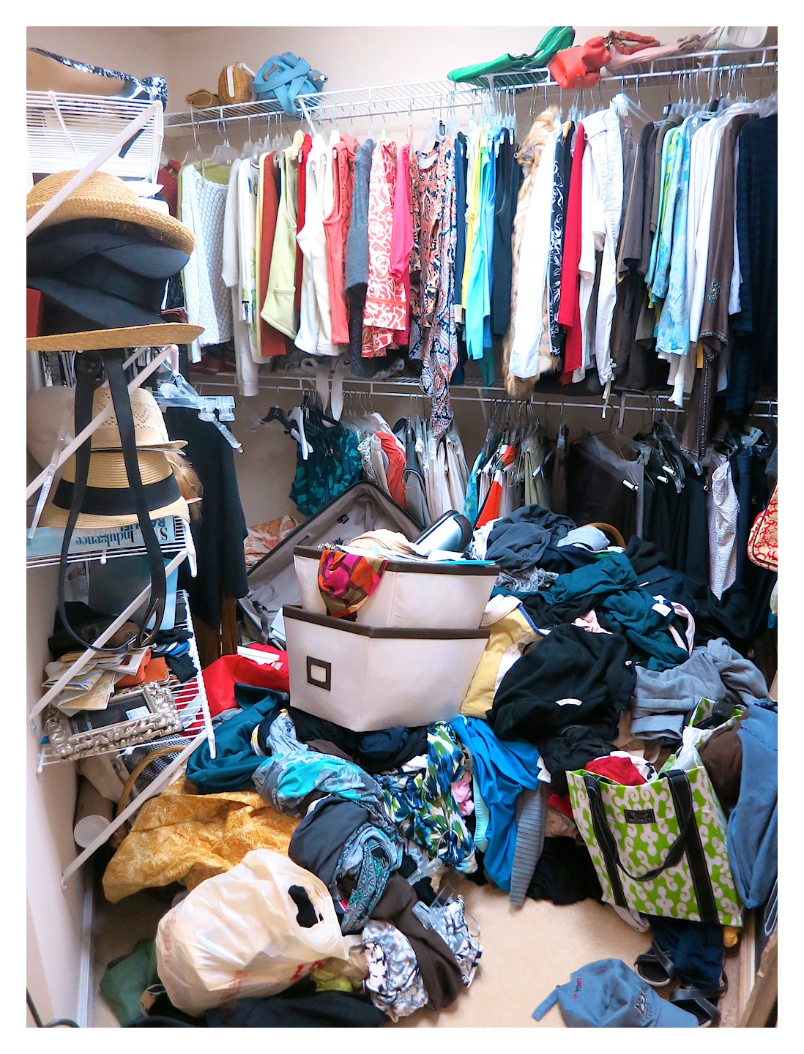
Priority Queues Implementations
Unsorted array
Add is FAST
Just throw it in the array at the back
O(1)
Remove/peek is SLOW
Hard to find item the highest priority item — could be anywhere
Might need to scoot over elements to fill gap
O(N)

Slide 7
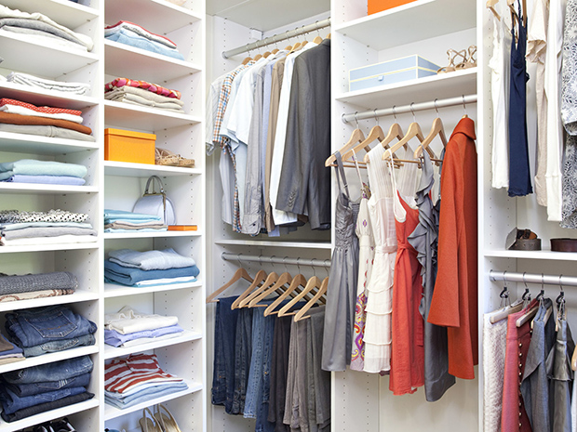
Priority Queues Implementation
Sorted array
Add is SLOW
Need to step through the array to find where item goes in priority -sorted order
If proper place is in the front/middle, need to scoot over other elements to make room
O(N)
Remove/peek is FAST
Easy to find item you are looking for (last in array)
No need to scoot over elements when removing last
O(1)

Slide 8
Is there a way to combine both?
+

Slide 9
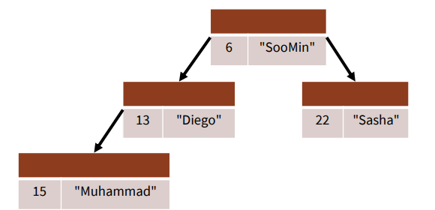
Binary Heap
Instead of storing our priority queue nodes entirely sorted or entirely unsorted, we will store them partially-sorted.
The partial sorting will still be stored in an array, but it’s best to imagine it as what we call a “tree” in computer science (computer science trees are upside-down for some reason ¯\_(ツ)_/¯)
Here’s what it might look like:

Slide 10
Binary Tree (Remembering)
“In computer science, a binary tree is a tree data structure in which each node has at most two child nodes, usually distinguished as "left" and "right."”
(Thanks, Wikipedia!)

Slide 11
Heaps
A heap is a binary tree (in which each node contains a Comparable key value), with two special properties:
The ORDER property:
For every node n, the value in n is greater than or equal to the values in its children (and thus is also greater than or equal to all of the values in its subtrees).
The SHAPE property:
All leaves are either at depth d or d-1 (for some value d).
All of the leaves at depth d-1 are to the right of the leaves at depth d.
(a) There is at most 1 node with just 1 child. (b) That child is the left child of its parent, and (c) it is the rightmost leaf at depth d.

Slide 12
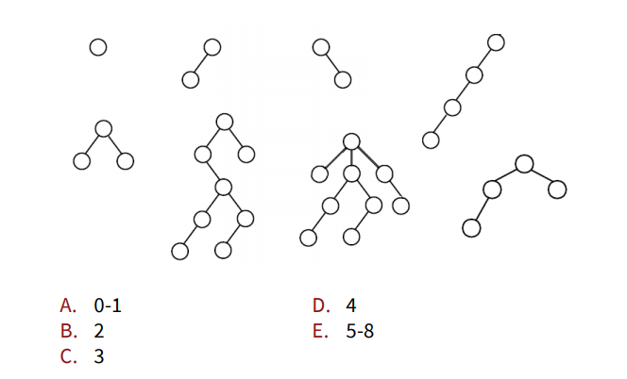
How many of these are valid heaps?

Slide 13
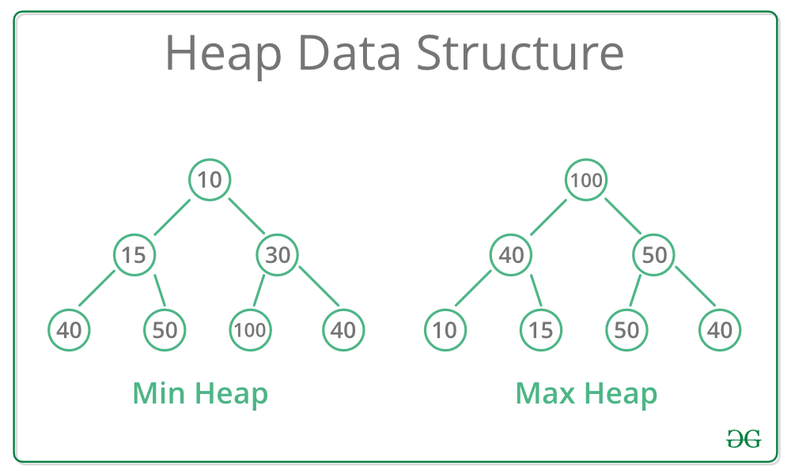
Heaps
Max-Heap: In a Max-Heap the key present at the root node must be greatest among the keys present at all of it’s children. The same property must be recursively true for all sub-trees in that Binary Tree.
Min-Heap: In a Min-Heap the key present at the root node must be minimum among the keys present at all of it’s children. The same property must be recursively true for all sub-trees in that Binary Tree.

Slide 14
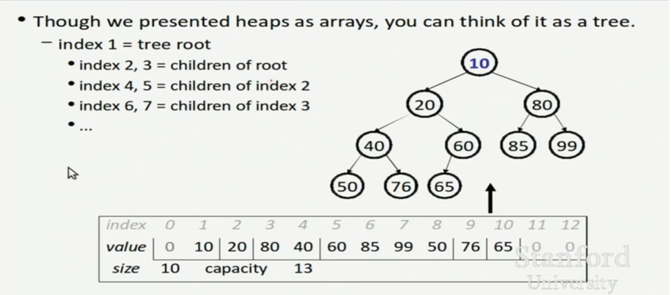
Heaps

Slide 15
How are Binary Heaps Represented?
How is Binary Heap represented?
A Binary Heap is a Complete Binary Tree. A binary heap is typically represented as an array
The root element will be at Arr[0].
Below table shows indexes of other nodes for the ith node, i.e., Arr[i]
Arr[(i-1)/2] | Returns the parent node
Arr[(2*i)+1] | Returns the left child node
Arr[(2*i)+2] | Returns the right child node

